Slide 1
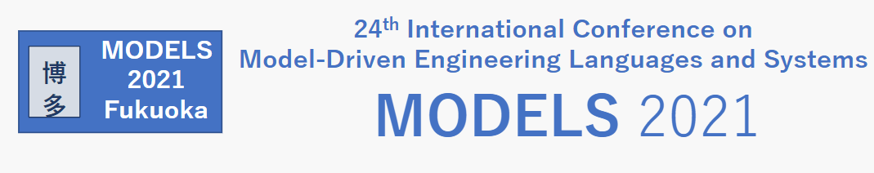


Distributed Model Validation with Epsilon
Sina Madani
Sina-Madani@hotmail.co.uk
Dimitris Kolovos
Richard Paige
dimitris.kolovos@york.ac.uk
richard.paige@york.ac.uk
https://github.com/epsilonlabs/distributed-evl
eclipse.org/epsilon

Slide 2
Motivation
Scalability is one of the main challenges in model-driven engineering
Large complex projects main beneficiaries of MDE approach
Such projects involve big models, many collaborators, complex workflows and model management programs
Most MDE tools not suitable for handling millions of model elements
Long execution times = lower productivity
One of the main benefits of MDE is working at higher level of abstraction to increase productivity
Therefore, improving performance of MDE tools is a good idea :)

Slide 3
Epsilon Validation Language (EVL)
Built on top of Epsilon Object Language (EOL)
Powerful imperative programming constructs
Independent of underlying modelling technology
A superset of Object Constraint Language (OCL)
Invariants may have dependencies on other invariants
pre and post blocks
Global variables
Cached operations
Fixes may be specified for unsatisfied invariants
...and more
Notes:
EVL is a hybrid language. It provides declarative structure like OCL but has general-purpose programming constructs.

Slide 4
Java hashCode and equals contract
@cached
operation AbstractTypeDeclaration getPublicMethods() : Collection {
return self.bodyDeclarations.select(bd | bd.isKindOf(MethodDeclaration) and
bd.modifier.isDefined() and bd.modifier.visibility == VisibilityKind#public);
}
context ClassDeclaration {
constraint hasEquals {
guard : self.satisfies("hasHashCode")
check : self.getPublicMethods().exists(method |
method.name == "equals" and method.parameters.size() == 1 and
method.parameters.first().type.type.name == "Object" and
method.returnType.type.isTypeOf(PrimitiveTypeBoolean))
}
@lazy
constraint hasHashCode {
check : self.getPublicMethods().exists(method |
method.name == "hashCode" and method.parameters.isEmpty() and
method.returnType.type.isTypeOf(PrimitiveTypeInt))
}
}
check : self.getPublicMethods()
Notes:
guard is equivalent to implies

Slide 5
Parallel execution
Unsatisfied Constraints
Validation Logic
context A {
constraint A1 {
check {…}
}
constraint A2 {
check {…}
}
}
context B {
constraint B1 {
check {…}
}
constraint B2 {
check {…}
}
constraint B3 {
check {…}
}
}
Constraint_A1
Context_A
Constraint_A2
2
3
2
1
3
1
5
4
5
4
Constraint_B1
Context_B
Constraint_B2
2
2
1
2
1
1
Constraint_B3

Slide 6
Data-parallel execution
for each context:
for each element of the context kind:
submit to executor service: ({
for each constraint in context:
if constraint-element pair has not already been checked:
if constraint is not lazy and constraint guard is satisfied:
execute constraint check block;
if check block returned false:
add constraint-element pair to set of unsatisfied constraints;
});
wait for jobs to complete;
Notes:
Execute the logic as before but with each element in a (potentially) different thread. Note that the order of evaluation is immaterial – they are independent.

Slide 7
What could possibly go wrong?
Concurrent access to mutable data structures
e.g. results, evaluated constraint-element pairs, caches at modelling layer
Variable scoping
How to deal with storage, retrieval and modification of local and global variables across different threads of execution?
Exception handling and error reporting
How to inform user where things went wrong with multiple threads?
Dependencies and lazy invariants
Re-evaluation vs. synchronization
Concurrency testing
Notes:
Lazy initialisation of data structures like caches can also be a problem.

Slide 8
From parallel to distributed
Main difference is lack of shared memory between computers
Models are highly interconnected graphs
Serialising large models is inefficient, so we need a better way
Objectives are:
Maximise CPU utilisation across all computers available to us
Minimise time spent on serialisation / deserialization
Minimise network traffic
Efficiently partition and allocate jobs
Program behaviour and semantics are unchanged

Slide 9
Prerequisites for our solution
All participating processes (“nodes”) need to have:
A full copy of the program (and its dependencies / imports)
Full access to the entirety of all model(s)
i.e. not partial models
The full codebase (JAR file for example) with dependencies
Ability to send and receive data from the master
Sufficient resources (disk space, memory) to execute the entire program
as with the non-distributed implementation
Bottom line: Replicate the master node

Slide 10
Distribution Strategy
Single-master, multiple-slave, asynchronous architecture
Master sends program configuration parameters to workers
Path to script, model(s), model properties etc.
Workers load model(s) and program into memory
Workers are sent pointers to jobs, not the jobs themselves!
Workers execute assigned job batches and send back results
Results are sent back as pointers too
Dependencies are re-executed on workers when needed

Slide 11
Atomic decomposition
Every EVL program can be decomposed into a finite, deterministically ordered List of rule-element pairs
A “rule” in our solution is the ConstraintContext
ConstraintContext defines model element types to be validated
We can create a job for every model element and add to a List
ConstraintContextAtom is a Tuple<ConstraintContext, Object>
That is, model element type (in the program) to model element itself
List<ConstraintContextAtom> is deterministically constructed

Slide 12

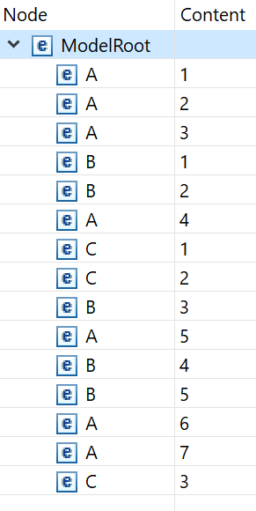


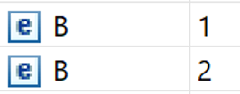


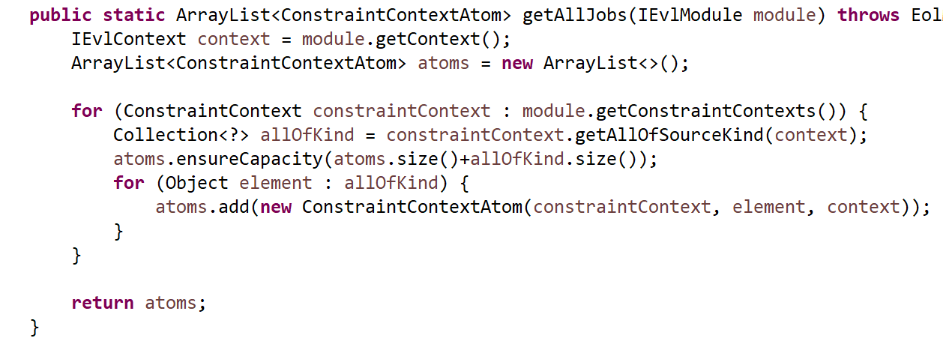
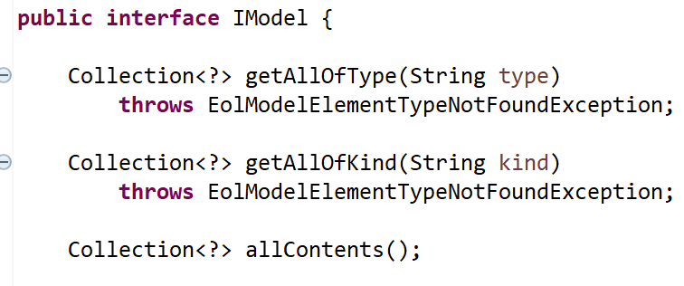
List<ConstraintContextAtom>
EVL
+
Model
context A {
constraint invX {
check {…}
}
constraint invY {
check {…}
}
}
context B {
constraint invX {
check {…}
}
constraint invY {
check {…}
}
constraint invZ {
check {…}
}
}
context A
1
context A
1
2
context A
2
3
context A
3
4
context A
4
5
context A
5
context B
6
context A
6
7
context A
7
8
context B
1
9
context B
2
…
…

Slide 13
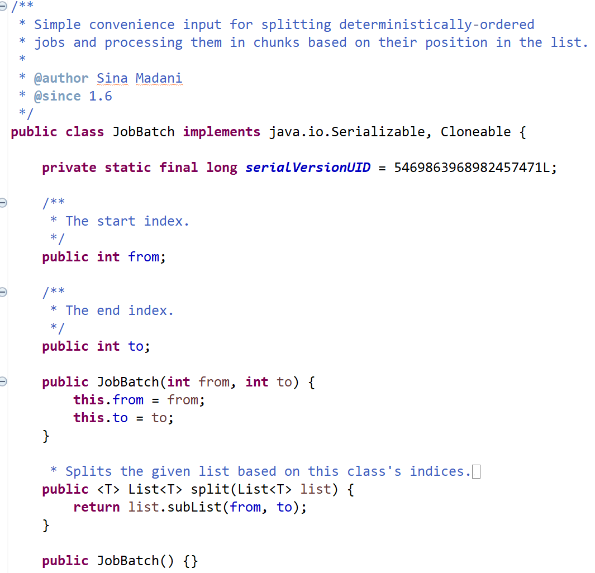
Splitting the Jobs List
List can be split into sublists based on indices
The number of sublists is how we define granularity of jobs
More chunks = smaller sublists = higher granularity
Split jobs to List<JobBatch>

Slide 14
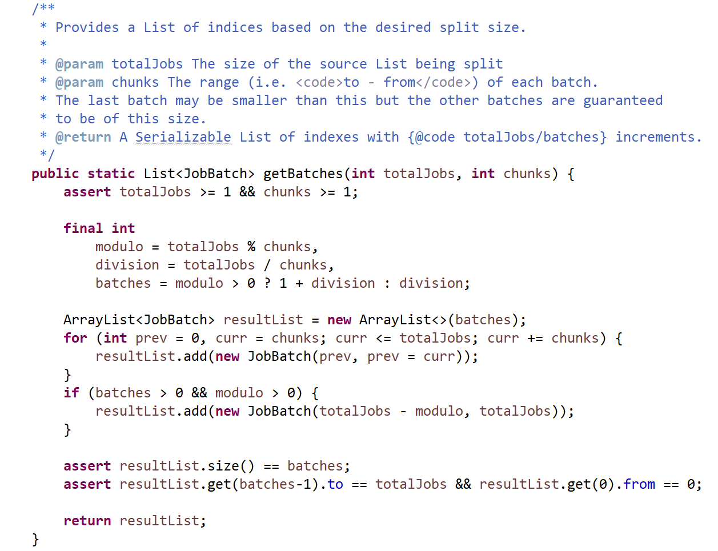
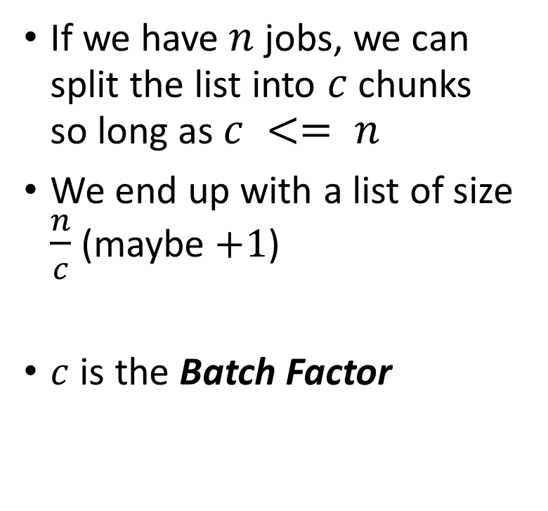
Splitting algorithm
If we have $n$ jobs, we can split the list into $c$ chunks so long as $c <= n$
We end up with a list of size $\frac{n}{c}$ (maybe $+1$)
$c$ is the Batch Factor

Slide 15
Example with batch factor = 3
List<ConstraintContextAtom>
List<JobBatch>
1
context A
Element 1
from = 1
2
context A
Element 2
1
3
context A
Element 3
to = 3
4
context A
Element 4
5
context A
Element 5
from = 4
6
context A
Element 6
2
to = 6
7
context A
Element 7
8
context B
Element 1
…
9
context B
Element 2
…

Slide 16
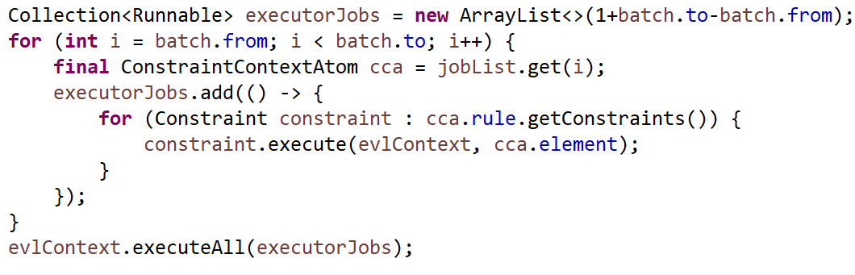
Executing a batch (simplified)
Loop through the batch indices
Find the ConstraintContext-element pair in the list at the index
Execute all Constraints declared within that ConstraintContext for the given model element, independently of other ConstraintContext-element pairs

Slide 17
Fairly distributing jobs
Shuffle the batches to ensure uniform distribution
Without static analysis, no way to know which jobs are demanding
Batch Factor should be equal to the maximum local parallelism
Local parallelism = Runtime.getRuntime().availableProcessors()
Any lower reduces throughput – want to maximise parallelism per node
Batches are lightweight, low-footprint
Broker implementation handles load balancing

Slide 18
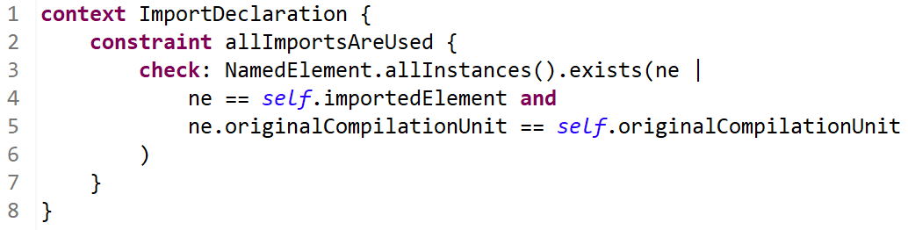
Performance
Lab machines with Intel i5-8500, 16 GB RAM, Samsung SSD
Reverse-engineered Java models
Data labels on bars show speedup relative to sequential EVL
Most demanding constraint:

Slide 19
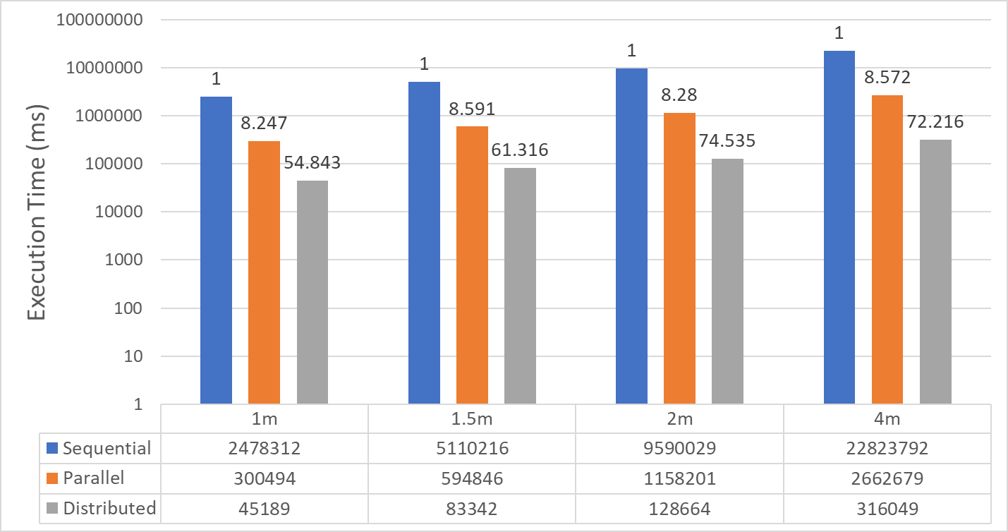
findbugs 16 workers
6 hrs 20 mins
85 mins
160 mins
41 mins
19 mins
44 mins
5 mins
10 mins
5 mins
2 mins
45 secs
83 secs

Slide 20
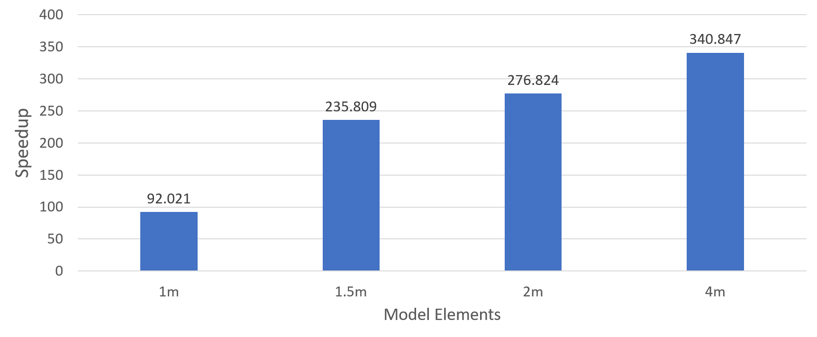
87 workers + AMD TR-1950X
69 seconds
35 seconds
22 seconds
27 seconds

Slide 21
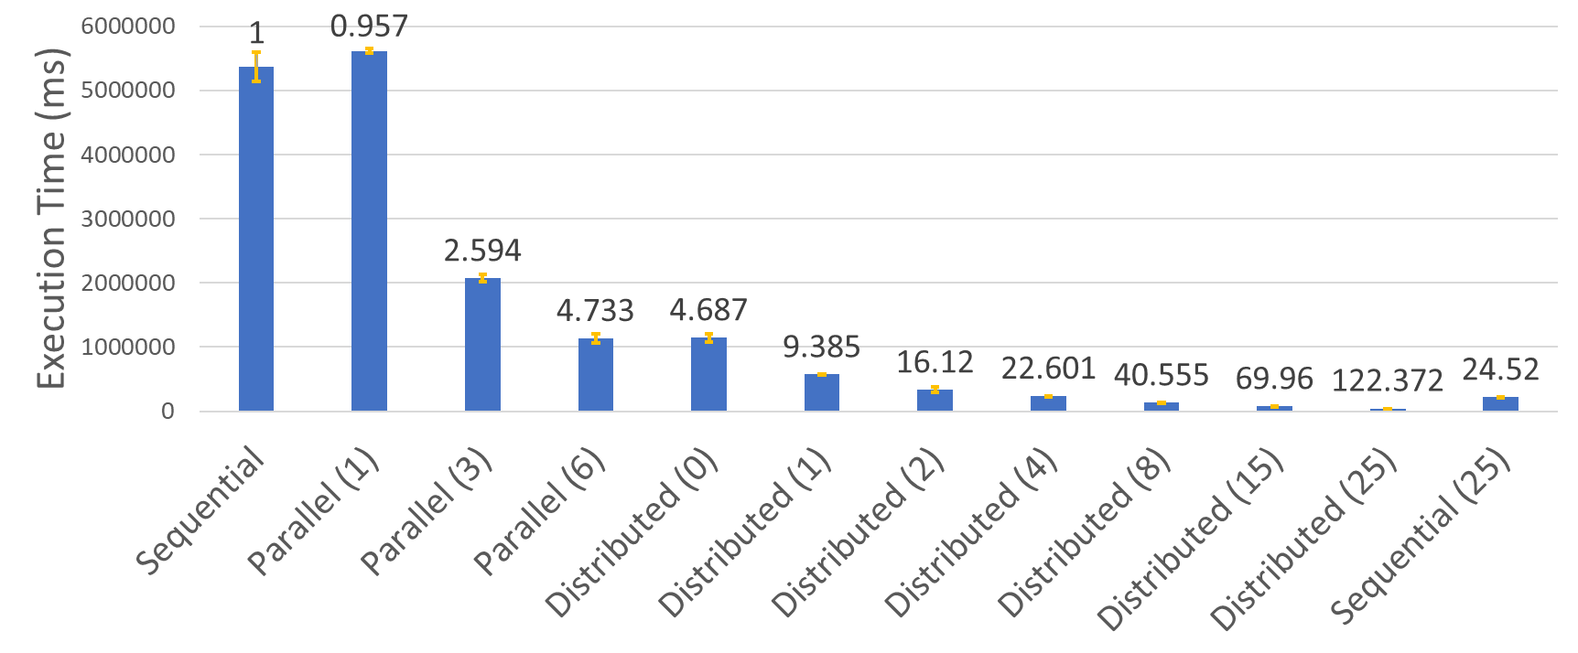
1Constraint 2 million elements (i5-8500)
100%
95.7%
% shows efficiency
86.5%
78.9%
78.1%
78.2%
89.5%
75.3%
75.1%
72.9%
78.4%
94.3%

Slide 22
Future Work
Build a UI for configuration in Eclipse (“DT plugin”)
Intelligent assignment of jobs
Maximise data locality
Potential for partial model / script loading
Requires static analysis
More experiments with different modelling technologies
On-the-fly / lazy model loading & element resolution
e.g. something like Hawk
Improve / fix Apache Flink implementation (currently a prototype)

Slide 23
Summary
Exploiting the finite and deterministic ordering of jobs can generalise to any other (read-only) model management task (in theory)
When model access is relatively cheap, speedup is exponential when combining parallel + distributed execution
Assumes all participating nodes have full access to resources
Experiment resources: github.com/epsilonlabs/parallel-erl
Implementation: github.com/epsilonlabs/distributed-evl
Paper: link.springer.com/article/10.1007/s10270-021-00878-x

Slide 24
Results processing
Send back serializable proxies of unsatisfied constraint instances
Index of model element in the job list
Name of the Constraint
Master lazily adds this to Set<UnsatisfiedConstraint>
“Deserialization” (resolving the element, message, constraint etc.) only occurs on demand for each individual UnsatisfiedConstraint
Workers send back aggregate profiling info when finished

Slide 25
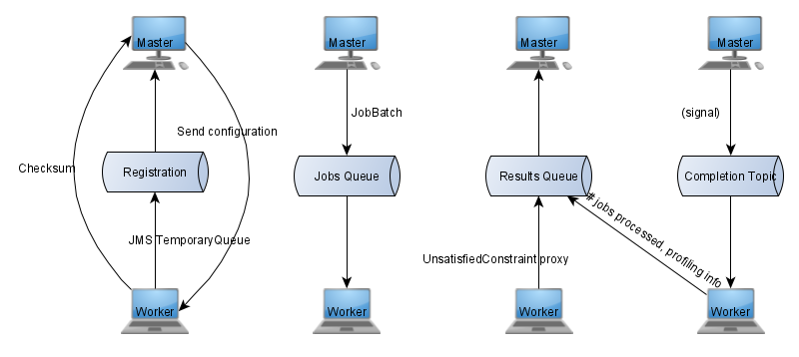
JMS 2.0 implementation
Messaging API used to facilitate communication

Slide 26
Worker arguments
“basePath” – used for locating resources
Configuration substitutes master’s base path with a token when sending config to workers
Workers substitute their own local absolute path when locating resources
Broker URL
e.g. tcp://127.0.0.1:61616
Session ID
To avoid conflicts between multiple running instances of distributed EVL on the same network
In practice, queue and topic names are appended with this ID

Slide 27
Asynchronous setup
MASTER
WORKERS
Command-line arguments
Command-line arguments
Base path
EVL script path
Models and their properties (paths, flags etc.)
Script parameters
Output file path
Base path
Broker URL
Session ID
1
Listen for workers on registration queue
Send configuration to workers
Signal presence to registration queue
1
2
Load configuration (script, models...)
2
Load configuration (script, models...)
Send workers jobs to jobs queue
Signal that all jobs have been sent to topic
Process results as they come in
Wait for all jobs (master & worker) to finish
3
Process next job from jobs queue
3
4
Send results from the job to results queue
4
Execute post block, report results etc.
5
Send number of jobs processed and profiling info

Slide 28
Single-threaded parallelism
Simulink driver is not thread-safe
Cannot use parallel EVL
Distributed EVL with localParallelism = 1 can help!
Each worker executes part of the script, so in theory should be faster
Tried this with 15 workers (i5-8500 lap PCs only)
Speedup was only 2.355
pre block took up a lot of time
Model access dominates execution time
Random distribution of jobs minimises data locality

Slide 29
Alternative performance solutions
MDE community focuses extensively on:
Model-to-Model transformations
Incrementality
Laziness
Incrementality and laziness avoid unnecessary work
Incremental suitable for large models where only small changes are made to the program and/or model
Requires delta caching – overhead which reduces regular performance
Does not improve performance when work cannot be avoided
e.g. absence of cache, no unnecessary code, large changes in model / program, first invocation…

Slide 30
Constraint Dependencies
Dependencies are uncommon
Inefficient to add and look up constraint-element pair every time a constraint is checked
Solution: a proxy
Check if constraint is a known dependency target
If so, check the constraint trace for the specific constraint-element pair, and add the result if not present
Otherwise proceed as usual with the check
Result: a dependency will be evaluated only twice at most
Notes:
See paper for details

Slide 31
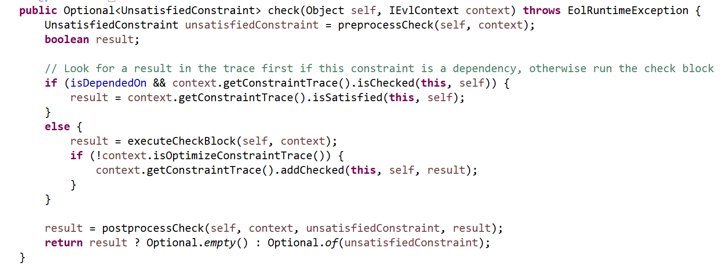
Constraint.check

Slide 32
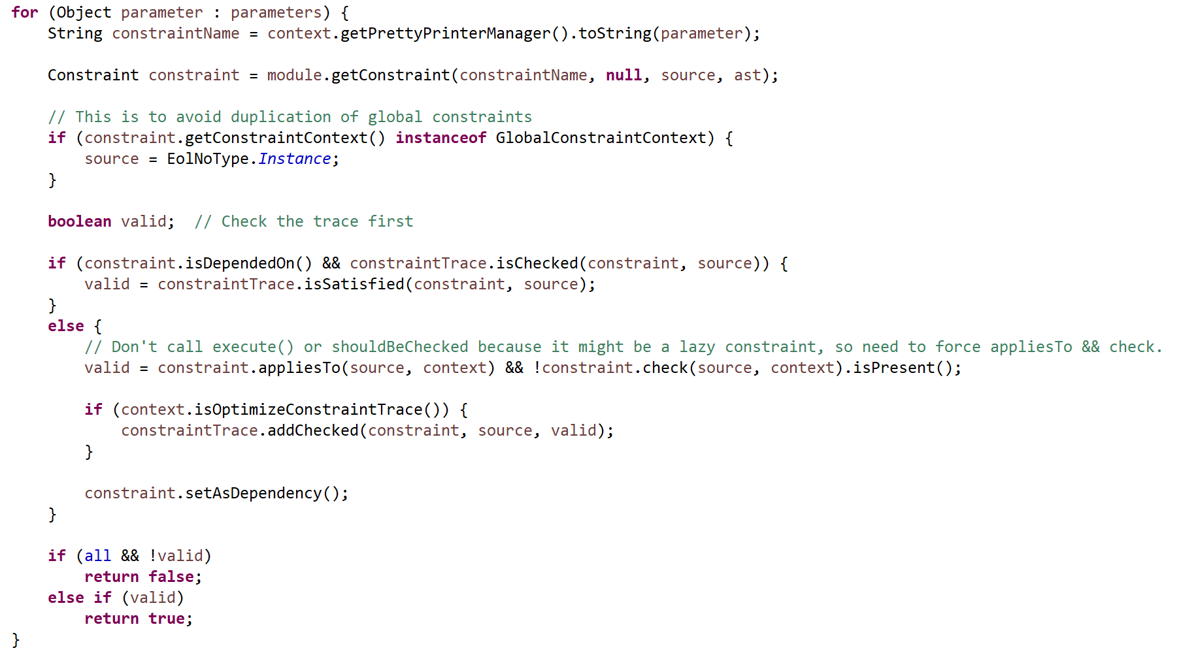
SatisfiesOperation

Slide 33


Constraint Dependencies
Unsatisfied Constraints
self.satisfies(“hasHashCode")
Checked Elements
Validation Logic
hasEquals
Constraint_A
ClassDeclaration
hasHashCode
hashHashCode
1
2
1
2
2
1
Constraints depended on
NOTE: hasHashCode is not lazy in this case

